Slide 1
ASSIGNMENT 5
TITLE – The Right Graph For Right Data
Name : Netal Prakash Daga
Roll no.: 271016
Prn no. : 22010244
Batch : A1

Slide 2
Contents
Task
Introduction
Resources
Issues and Challenges
Proposed work
Result and Conclusion
References

Slide 3
TASK
Prepare a presentation to demonstrate "Right Graph for Right Data". Take appropriate case studies to explain with significance (Any 5)
Visualize the data using right charts which will ensure your message is clear and accurate.

Slide 4
INTRODUCTION
This dataset is downloaded from kaggle. It is about how many students from each stream has done how many internships & how many are placed.
We’ll consider that a University Announced Its On-Campus Placement/internships records.
Used This Data to Predict and Analyse Whether A Student Gets Placed, based on how many numbers of internships they have done.
This dataset is for the college professors and placement team.

Slide 5
RESOURCES
Tableau Public 2021.3
Dataset from Kaggle
Excel

Slide 6
Issues and Challenges
Selecting a proper dataset to create the different types of graphs.
The choice of graph, colours.
Including too many variables.

Slide 7
PROPOSED WORK
Made 10 graphs; 2 graph of each title (for comparison of different type of charts) for audience.
From them selecting the best one.

Slide 8
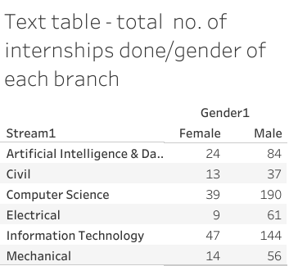
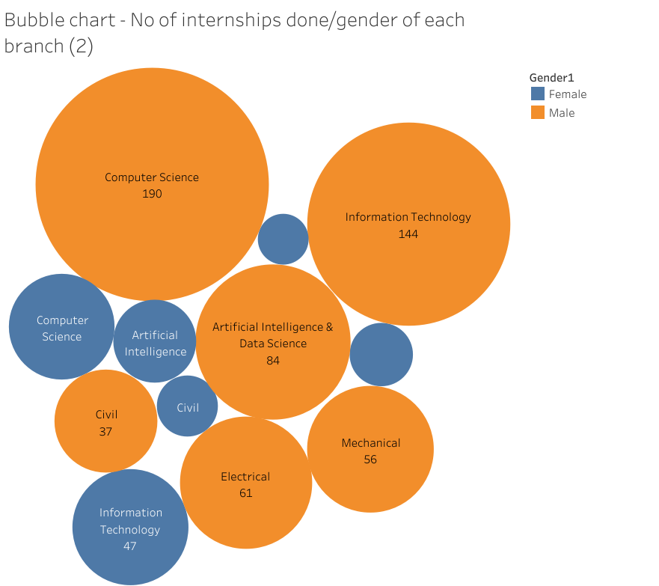
RESULT AND DISCUSSION
1
Here we are showing Total no. of internships done Vs. gender (from each branch).
So, by comparing both the graphs; we can conclude that the text table is more accurate then bubble chart.
As, text table is easily understandable and readable.

Slide 9
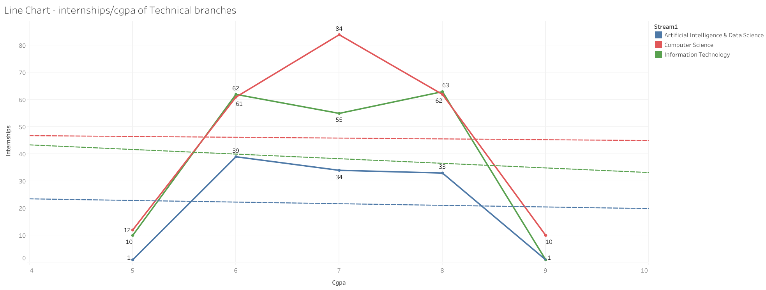
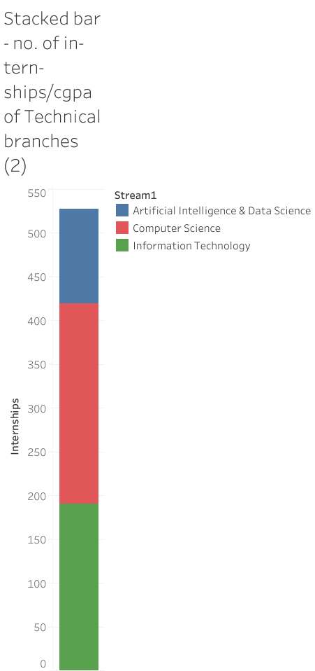
Here we are showing Total no. of internships Vs. cgpa (of each technical branches).
So, by comparing both the graphs; we can conclude that the Line chart is more accurate then Stacked bar chart.
As, line chart is easily understandable and readable, with those trend lines.
2

Slide 10
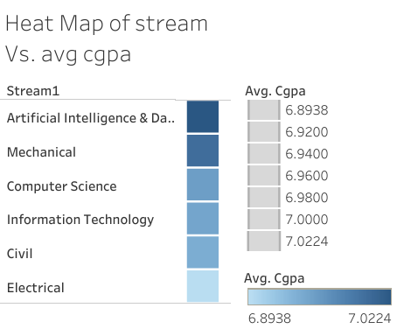
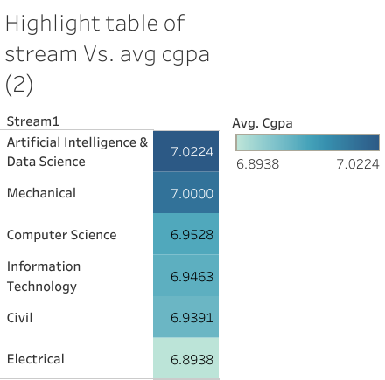
3
Here we are showing average cgpa of each stream.
So, by comparing both the graphs; we can conclude that the Highlight table is more accurate then heat map.
As, highlight table is easily readable & understandable.

Slide 11
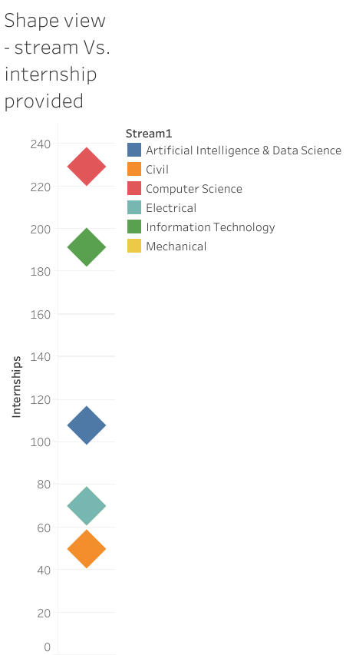
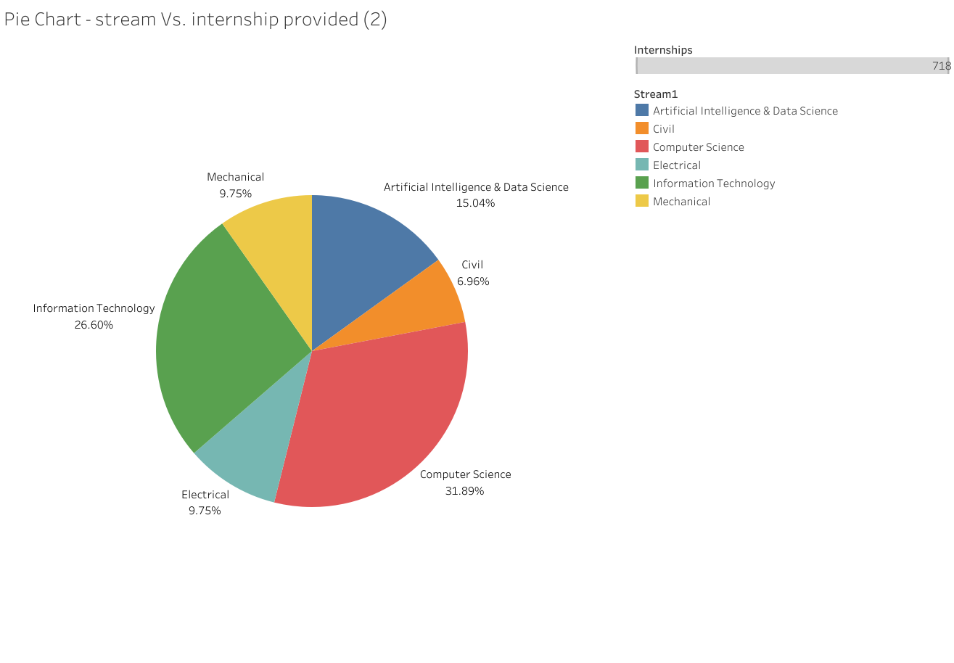
4
Here we are showing no of internships provided per stream.
So, by comparing both the graphs; we can conclude that the Pie chart is more accurate then bubble shape view.
As, pie chart is easily understandable and readable.

Slide 12
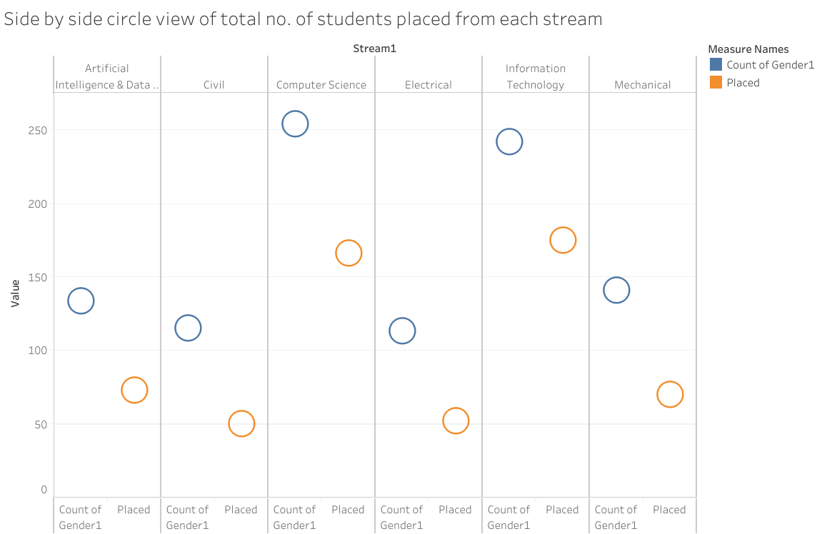
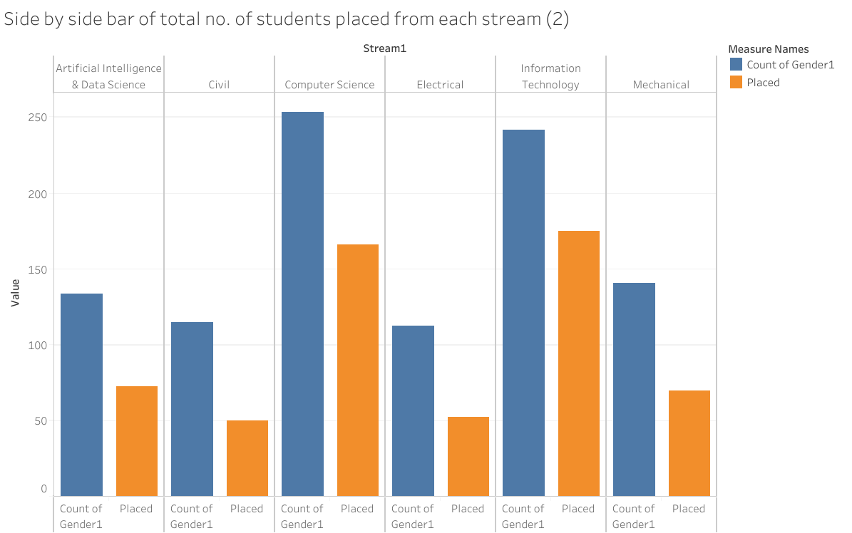
5
Here we are showing comparing total count of students in each stream Vs. from them how many are placed.
So, by comparing both the graphs; we can conclude that the Side by Side bar chart is more accurate then side by side circle view chart.
As, side by side bar chart is easily understandable and readable.

Slide 13
Conclusion
A line chart reveals trends or change over time. Line charts can be used to show relationships within a continuous dataset.
Pie charts are used to show parts of a whole.
Bar and column charts are used to compare different items.
Text table is used for organised data and specially for numeric data to make it easy to understand.
Bubble chart are appropriate when we want to show relationships between three or four variables but not their exact values.
Use highlight tables to compare categorical data using color with range.

Slide 14
References and links
Dataset: https://docs.google.com/spreadsheets/d/1ASHKT2M6Jmt_ebFQwUHwEIjKk9DokakRFtYZNXgbRKQ/edit#gid=0
My Visualisation: https://public.tableau.com/app/profile/netal.daga/viz/Engineering_internshipsplacementsAssign5/Texttable-totalno_ofinternshipsdonegenderofeachbranch

Slide 15

Thank you !!!

